Slide 1

G.O.T.E
A Script Analysis Method

Slide 2
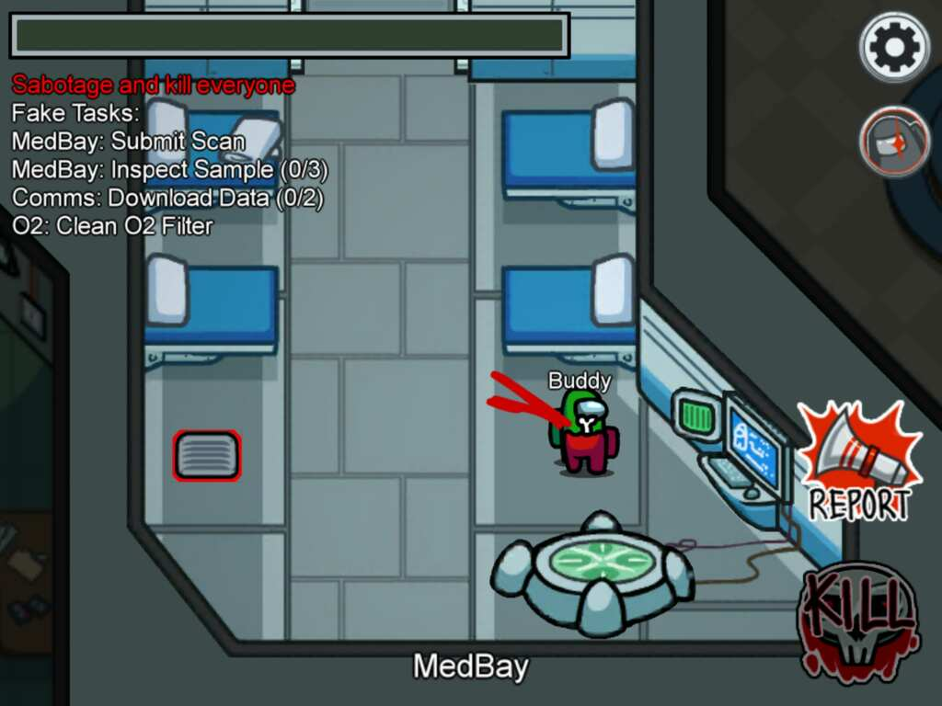
Imposter
Sabotage and kill everyone
Fake Tasks:
MedBay: Submit Scan
MedBay: Inspect Sample (0/3)
Comms: Download Data (0/2)
O2: Clean O2 Filter

Slide 3
G: GOAL (Objective)
Super Objective
Scene Objective (s)

Slide 4

Superobjective
One for the whole play
  A shift in super-objective may be a major plot point (eg. Elle realizing she doesn’t want Warner back at the end of Act I of Legally Blonde)
Something that fulfills a fundamental human need
Big and not easy to get

Slide 5

Scene Objective
May be more than one per scene
  Can either be accomplished or abandoned
Always in service of the superobjective

Slide 6
Which of these is the SUPEROBJECTIVE?
Sabotage and kill everyone
Fake Tasks:
MedBay: Submit Scan
MedBay: Inspect Sample (0/3)
Comms: Download Data (0/2)
O2: Clean O2 Filter
This one is the WIN condition.
So why do we do these?

Slide 7

O: Obstacle
Often a list of complicating factors
Relate your OBSTACLES to the OTHER in the scene
  Is the OTHER an OBSTACLE?
  Is the OTHER a potential ALLY?

Slide 8
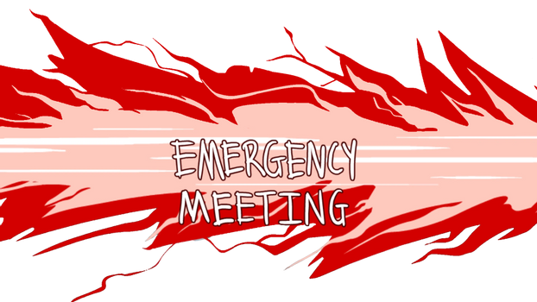

O: Obstacle

Slide 9
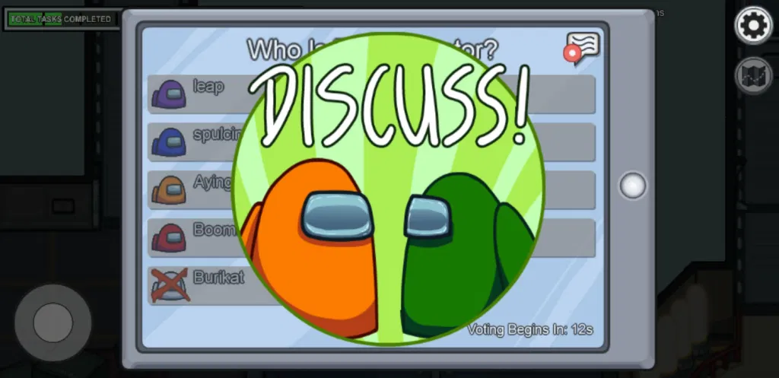
O: Obstacle
If the crewmates figure out who you are, they will throw you out the airlock.

Slide 10
Scene Objectives are in response to the OBSTACLES
Sabotage and kill everyone
Fake Tasks:
MedBay: Submit Scan
MedBay: Inspect Sample (0/3)
Comms: Download Data (0/2)
O2: Clean O2 Filter
These smaller objectives are because of the OBSTACLE.
If you get caught, you cannot sabotage and kill everyone.

Slide 11

T: Tactics
Strategies you try to achieve your goals
Must be done to the OTHER
Verbs/Verb Phrases

Slide 12
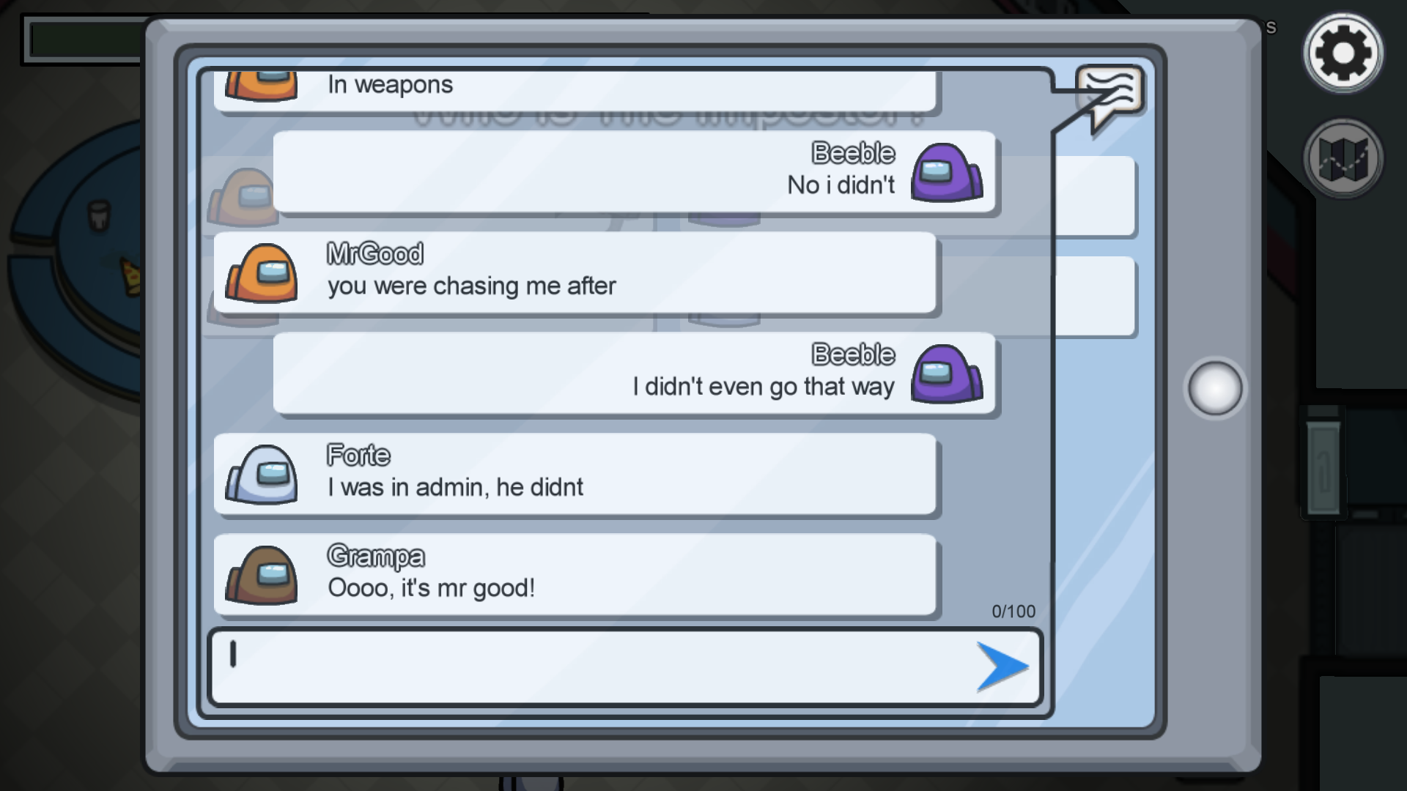
T: Tactics
What are some tactics you try in meetings to avoid suspicion?

Slide 13
T: Tactics
Accuse: “I saw blue walking out of Electrical right after the lights went out!”
Put Them At Ease: “This is my first time on the map. I don’t know where I’m going.”
Butter Them Up: “I know it’s not blue because he was swiping his card when it happened.”
Command Them: “Orange is a liar. Skip the vote!”

Slide 14
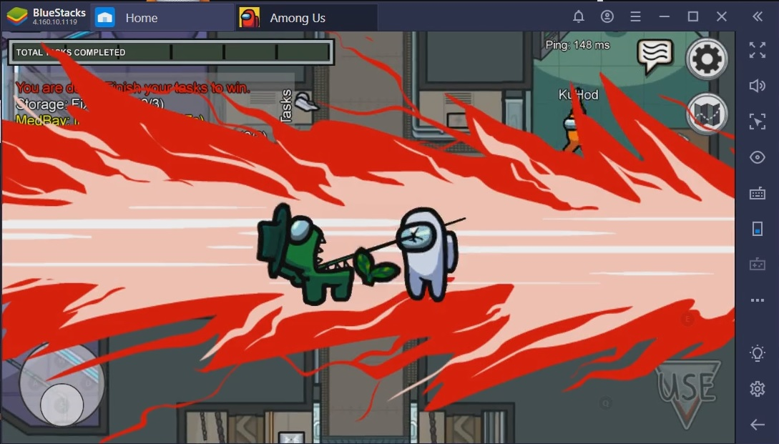
E: Expectation
What do you expect to happen as a result of your actions?

Slide 15
E: Expectation
TACTIC:
Badger them into voting for blue.
EXPECTATION:
They will vote blue and then you will be safe.
WHAT HAPPENS:
They skip!
NEW TACTIC:
Guilt trip them about not choosing blue.
“Now Red is dead because y’all didn’t listen to me!”

Slide 16
E: Expectation
TACTIC
EXPECTATION
Does it Happen?
YES
NO
Cool!
Now work on the next objective.
Drat! Try something else.

Slide 17

Imposter
Imposter
Imposter
Imposter
Imposter
Orange is sus.
Vote him out.

